Slide 1
College of Education: Quest for Continuous Improvement
AAAT Meeting
February 12, 2015

Slide 2
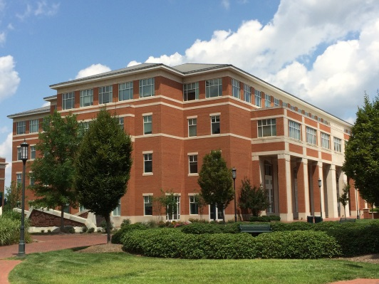
Overview
Context for Continuous Improvement
Three Levels of Accreditation
Meeting Multiple Expectations
Challenges
Implications & First Steps
edTPA
Next Steps

Slide 3
Context for Continuous Improvement

Slide 4
Three Levels of Accreditation: Program, College, University
State Board of Education (with support from DPI) approves all programs that grant licensure
Set specific outcomes and content expectations for every program( 56 programs including programs housed in CLAS and in CoA+A – 9 programs do not fall under state guideline)
Candidates must meet the North Carolina Professional Teaching Standards (NCPTS)
Program

Slide 5
Three Levels of Accreditation: Program, College, University
NCATE (now CAEP) awards the College national accreditation
National accreditation is required of all UNC educator preparation programs (EPP) by the Board of Governors.
CAEP will serve as the Federal proxy under the proposed federal regulations for educator preparation programs (EPP)
Sets specific standards for the College such as:
Content learning expected and candidate’s ability to deliver that content,
Clinical practice,
Checking quality of candidates at multiple phases
Impact of our completers to positively improve P-12 learning after they leave our programs
Maintaining a quality assurance plan that uses multiple measures that are sustained and evidence-based.
CACREP – Program specific national accreditation for counseling program
College

Slide 6
Three Levels of Accreditation: Program, College, University
SACS accredits the University which allows it to award degrees that are recognized across the US
Looks at University operations
Expects all programs to met well designed student learning outcomes
University

Slide 7
Meeting Multiple Expectations
Dilemma – How do we address so many expectations without going crazy!!
Use NCATE/CACREP student learning outcomes as a guide for developing the SACS SLOs
Use specific measures required for state evidences to show competencies in student learning outcomes.

Slide 8
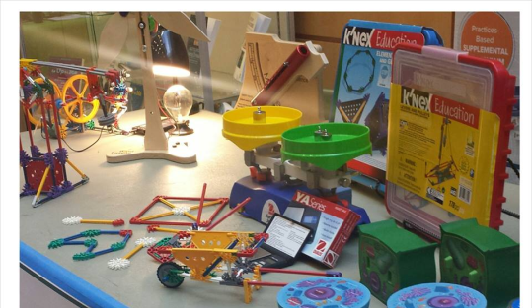
Meeting Multiple Expectations
Example – SLO 5

Slide 9
Challenges
State expects every competency to be met “at standard” or above. Means we must work toward “Mastery Learning” which skews feedback we get.
How valuable is the data when mastery is always the end product?
It does not give you enough evidence to use when making program decisions.
Increasing political climate with focus on education
UNC Board of Governors held an Education Summit on Jan. 27 which also sets expectations for the educator preparation programs outside accreditation
New Federal Regulations being proposed for outcome measures which use post-graduation measures to grade our programs. New rating system based on
SLO – Value added after they leave us
How many get jobs and how many stay in their jobs
Surveys sent to Graduates and Employers
CAEP and/or DPI approval
(Might affect funding for students.)
Fewer people want to be a teacher: Decreases in the State funding hit perspective teachers very hard (no pay for Masters, no Teaching Fellows and reduced scholarship help) – Remember the Moral Monday Marches.
Beyond Accreditation

Slide 10
Implications & First Steps

Slide 11
Implications
We must address all of these expectations in addition to outcomes expected by accreditors.
To do this, new assessments will be needed.
Also new SLOs will be needed as we move to CAEP and their new outcomes.

Slide 12
First Step
Follow the Comprehensive Assessment Plan (http://edassessment.uncc.edu/home/comprehensive-assessment-system)
College takes approximately 2-3 years before a new assessment is ready to be fully implemented with consequences for candidates.
Given political pressures we need a more independent, nationally administered measure for program data may help us meet that external scrutiny.
A nationally administered measure for program data may give us more variability in our data upon which to make decision.
A bold step forward – where we are now:
edTPA (a new student teacher performance assessment developed by the Stanford Center for Assessment, Learning and Equity (SCALE) and nationally administered by Pearson.)
Practice Tasks for edTPA to prepare the students
Development of new SLOs to meet CAEP expectations
Revision of Assessment plans for all programs to address new SLOs and instruments.
In the interim, we continue to collect current data plus new data as we transition. DPI has approved our candidates submitting parts of edTPA as evidences for required state evidences.

Slide 13
edTPA

Slide 14
What is edTPA?
A comprehensive, portfolio assessment developed by Linda Darling-Hammond and her colleagues from Stanford (SCALE)
Designed to answer the question: “Is the candidate ready to teach?”
Mirrors National Boards process for currently practicing teachers

Slide 15
Candidates complete edTPA during the student teaching capstone experience
Products submitted to third-party scorers trained by SCALE, administered by Pearson
Phasing in as a requirement for teacher licensure

Slide 16
Red = policy in place Green = developing policy Beige = at least one IHE
596 Educator Preparation Programs in 33 states + District of Columbia
(1/27/2015)

Slide 17
Structure of the Portfolio--Two types of evidence: Artifacts & Commentaries
Planning | Instruction | Assessment
Instructional and social context Lesson plans and Instructional materials, student assessments Planning Commentary | Video Clips Instruction Commentary | Analysis of whole class assessment Analysis of learning and feedback to THREE students Assessment Commentary
Analysis of Teaching Effectiveness Academic Language Development

Slide 18
Rubric Blueprint – specific to content area
Task name: Rubric Title Guiding Question:
Level 1 | Level 2 | Level 3 | Level 4 | Level 5
Struggling candidate, not ready to teach | Needs more practice | Acceptable level to begin teaching | Solid foundation of knowledge and skills | Highly accomplished beginner
15 rubrics are assessed for most edTPA portfolios (5 for each Task)

Slide 19
Timeline of edTPA Implementation
2012-2013:
2013-2014:
Fall 2014:
Exploring, Learning, Sharing
Begin to embed skills and knowledge in courses
First edTPA products completed during student teaching (Elementary, Middle Grades/Secondary, TESL, Foreign Language)
Spring 2015:
edTPA products added: Special Education, Early Childhood
Fall 2015:
edTPA products added: Fine and Visual Arts (all programs fully implemented)

Slide 20
“What does my score mean?”
Process for setting cut score followed SCALE recommendations
“Passing” at UNC Charlotte = 35 / no scores lower than 2 on individual rubrics (rubric average 2.33)
Plan to raise cut score over four semesters to 37 (rubric average: 2.47) → national minimum recommendation

Slide 21
Fall 2014 results
147 candidates completed edTPA
74 Elementary candidates
Elementary: 90% of Fall 2014 candidates passed with current criteria

Slide 22
Next Steps

Slide 23
Next Steps
We are beginning to analyze the results
Programs are getting feedback from instructors and students
Programs are looking at the practice tasks and making adjustments as needed.
New SLOs will be developed over the next year to include CAEP expectations
edTPA (tasks and final projects) will be mapped to the new SLOs
Current assessment tasks will be kept as needed and mapped to the new SLOs
Full implementation of new SLOs will begin
New assessment will be used for decision-making as soon as they have been validated as effective measures.

Slide 24
Questions

