Slide 1
Capturing Student Learning Outcomes via
A Collaboration between the Center for Teaching & Learning and the College of Computing & Informatics
AAAT Meeting December 12, 2017 Audrey Rorrer, Bruce Richards

Slide 2
College of Computing & informatics
31 Degree Programs
2
4
7
2
10
PhD Programs
Masters Programs
Certificate Programs
Undergraduate Degrees
Concentrations
6
Minors
2,790 Total
77% increase over last 5 years

Slide 3
CCI Assessment Context
Challenges
Cumbersome Data Collection
Reporting Burden on Faculty
Data Integrity
Opportunities
Scale Data Collection
Remove Faculty Burden
Faster Dissemination
Enhanced Performance Knowledge

Slide 4
CCI Assessment Process
Spreadsheets
VS
Canvas Pilot
Faculty receive reporting spreadsheet
Faculty grade assignments
Faculty report SLO outcomes by degree program
CAD aggregates by degree program
Report to the Chairs
Faculty score assignments
CAD creates SLOs & Rubrics in Canvas
Faculty link to the Rubric & set mastery level
Faculty grade as usual
CAD downloads & aggregates Canvas Reports
Report to the Chairs
~15 Minutes
Hours of Extra Work
Compliance (macro)
Formative
(micro)

Slide 5
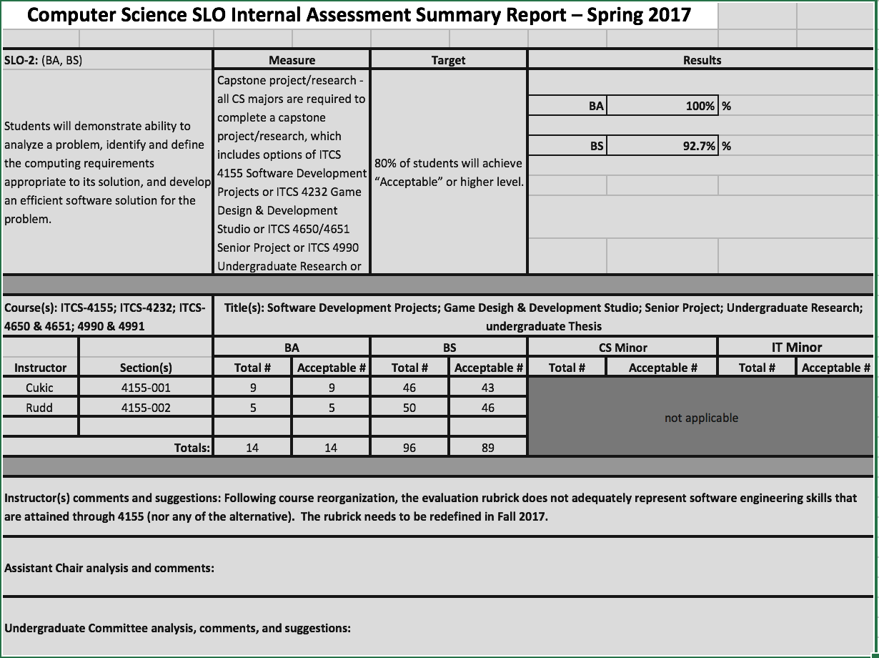
Ye [Olde] Spreadsheet
Dozens of these each term
No Score

Slide 6
The 2017 Pilot
Spring Term: RUBRICS
5 Program SLOs
3 Faculty 4 Course Sections 264 students
Fall Term: TEST BANKS
1 Program SLO
1 Faculty 1 Course 51 students
SLO 2: Analyze/Solve Computing Problem
ITCS 4156
Intro to Machine Learning
SLO 3: Teamwork
ITIS 3155
Software Engineering
SLO 4 A & B:
Written/Oral Communication
ITCS 3688
Computers & Their Impact on Society
Web/Apps Concentration SLO: Create Static WebApps
ITIS 2300
Web Based App Development
BINF SLO 3: Awareness of Research in BiG
BINF 1101
Intro to Bioinformatics & Genomics
Notes:
Stacey, Dale Marie, Nadia Najiir, Larry Mays

Slide 7
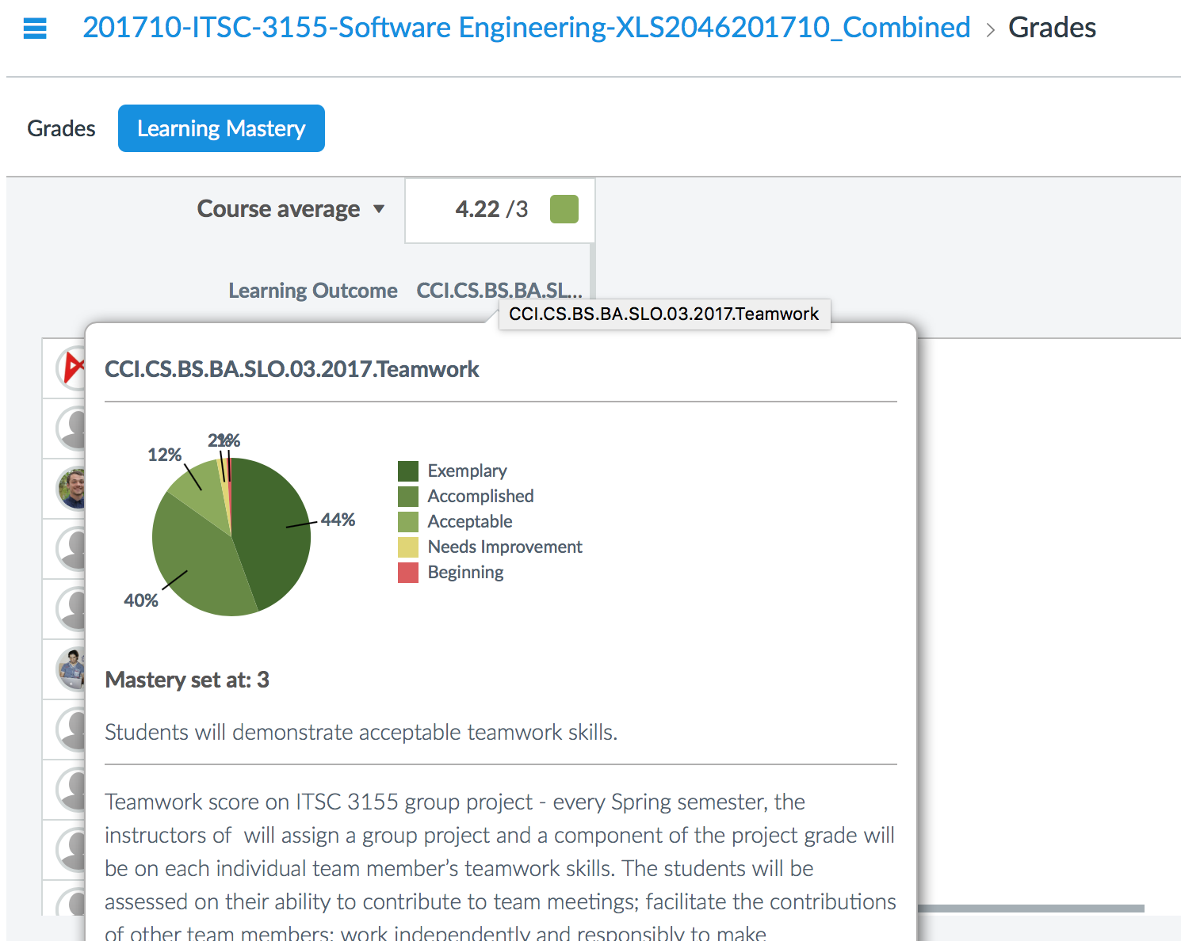
The Canvas Output- Faculty View
What Faculty see
Administrator gets an aggregate spreadsheet of all SLO outcomes

Slide 8
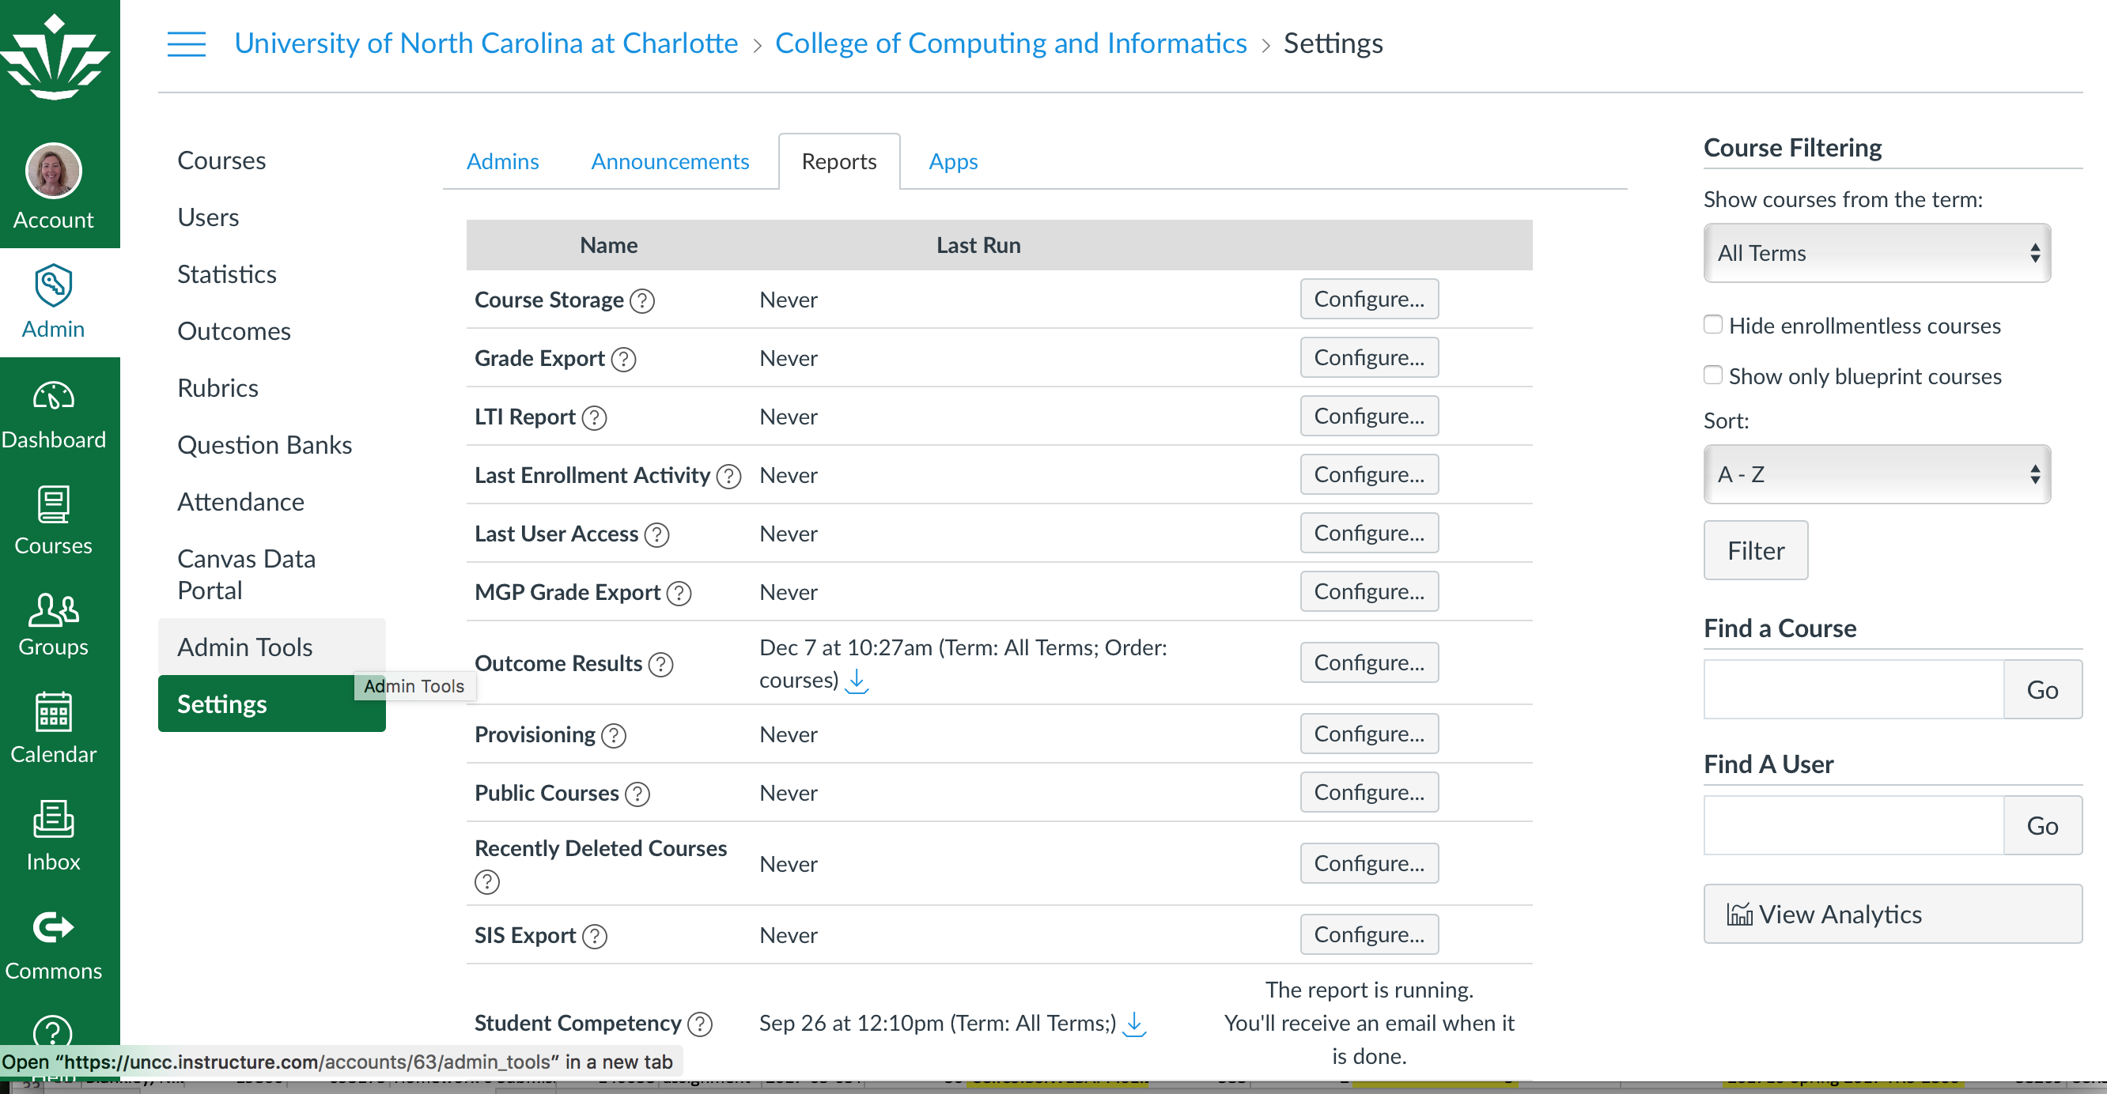
The Canvas Output- CAD Reports

Slide 9
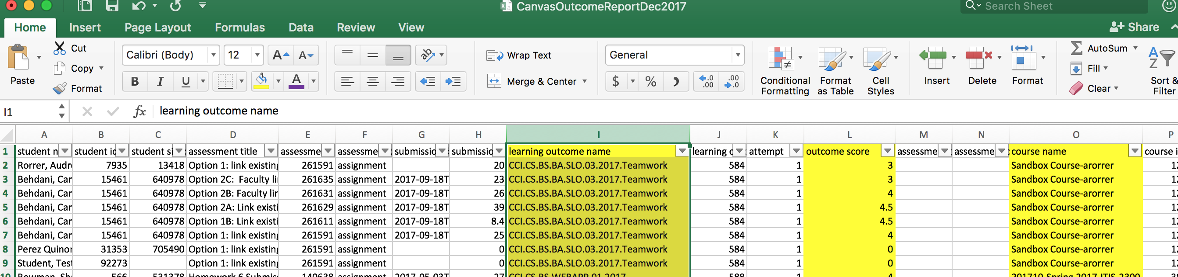
The Canvas Output- CAD Reports
SIS ID in Banner
The standard Canvas Reports show the total Rubric Score
CTL Special Report shows sub-criteria scores

Slide 10
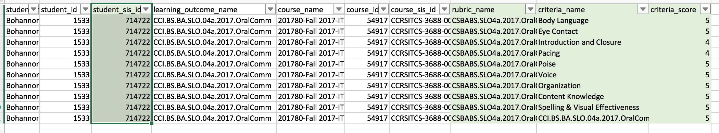
The Canvas Output-CTL Report
SIS ID in Banner
CTL Special Report shows sub-criteria scores and the Total Rubric Score

Slide 11
Linking Canvas Reports to Banner Data
One Approach:
Pull Canvas Reports (or CTL) into excel
Pull Course Grades Report for CCI in Report Central
  Final Grades by College, Department, Course for Term report
Pull [new] report of SIS IDs in Report Central
Cross-Walk the SIS ID to Banner Student ID
Address your assessment questions, e.g.
  View demographic patterns of students who don’t meet performance criteria
    Is pass/fail related to prior course performance, math scores, etc.?
    Is pass/fail related to transfer status and particular transfer credit courses?
Linkage between Sis ID and Banner SID

Slide 12
Lessons Learned
Administrative
Review SLOs and Rubrics
Establish naming conventions
Work Load Shift
Burden of work on the CAD
Policy Implications
Departments and Colleges make KEY decisions
Bulk of it in the Canvas set up
This is a one time event :)
Faculty Buy-In is critical
Rubrics are permanent in Canvas once used
Additional Challenges
Rising Enrollment & Scaling

Slide 13
Considerations
Key Decisions
Ensure rubric alignment with unified degree
Collaborate with NEW Course Coordinators
Pilot Test Bank Questions in BINF Minor
Tailor a roll out plan for faculty based on CCI decisions
Develop How To Materials
Next Steps
Considering Test Bank Items over Rubrics in some cases
Garnering Faculty Support
How to actually scale

Slide 14
Live demo
Rubrics:
View Stacey Watson’s ITCS 3155 spring 2017 course
View Outcomes Testing Course to view rubric score options
Test Bank:
View Larry May’s BINF 1101 fall 2017 course
Report Generation:
View Canvas report pull

Slide 15
Thank you

