Slide 1
College of Computing & Informatics Educational Initiatives for Undergraduate Programs
AAAT Meeting
September 11, 2014
Audrey Rorrer

Slide 2
Overview
Context: Challenges and Solutions
Assessment Process
Examples and Preliminary Results
Lessons Learned
Future Directions

Slide 3
CCI Challenges & Solutions
Pipeline
Limited discipline exposure in High School
Graduation
Concerns:
Degree maps
Social relevance and interdisciplinary campaign
Focus:
Concerns:
Retention
Concerns:
Entry level course DFWs
Focus:
Focus:
Image of computing
Center for Education Innovation
Low diversity
Climate: peer and faculty approachability
UNIFIED DEGREE
Computing Professionals courses (Prospect for Success)
Teaching Initiatives: engagement, pathways, course splits
<20% nationally
Time to graduation
Prospect for Success for transfer students
Transfer student credits
The T Shaped Professional
Challenge
Solution
Notes:
Pipeline- i.e our recruiting challenges are that students don’t get CS in high school, and if they do, it’s an elective and taught very differently across schools, so students who are interested are often underprepared. With very little minority and female student enrollment nationally in CS majors, we are striving to appeal to women and underrepresented minority groups.
About 14% women nationally and 16% URM
In all recruiting and outreach events, we focus on the social relevance of computing and the interdisciplinary or applied nature of computing; we formed the CEI last year to wrap all our educational initiatives, grant funded or not, under a single umbrella to spotlight these initiatives and help drive extracurricular funding support
Retention
Large entry level (CS 1,2,3) courses create teaching and learning issues. The coursework is scaffolded in a hard science so not getting it in CS 1 causes problems later on;
I call this next concern climate, but many of the faculty would not use this label, what I’m referring to is the individual nature of the learning and the large size of courses makes connections with faculty and peers difficult, less approachable;
Focus on engagement of undergraduate students, facilitating and clarifying their pathways through to degree, and section splitting among other thins we’ll discuss momentarily; I won’t discuss all the initiatives underway, but will focus on the primary ones where we expect highest return on investment
Graduation
Once we get them in, we need to get them out in a timely fashion, and have particular issues with transfer credits
Degree maps help student plan their matriculation which work in tandem with advising; we have a career advisor instructor
Prospect for Success is also offered especially for transfers to focus on their unique circumstances
The T Shaped Professional (broad professional skills, deep technical skills) is thread throughout the curriculum in project assignments

Slide 4



Key Educational Initiatives
1212 Split/4 credits
Flipped Classrooms
Pathways
Engagement: CS Professionals
Notes:
Our Engagement Initiatives:
Prospect for Success- it’s a professional development course and orientation to the majors designed to get students connected to one another and to the faculty. Guest speakers from faculty and industry showcase social relevance, career possibilities and how they can engage on campus both within the college and on the whole campus
Pathways for Women- a grant from the National Center for Women & Information Technology that we have with the College of Engineering to devise a marketing and outreach campaign targeting women but will impact men too. We are establishing minors and have student ambassadors to go into courses to talk about the interdisciplinary nature of our programs, for example how nursing or CJ majors might benefit from a minor in computer science
STARS is a service learning course in computing where students teach cs concepts in local middle schools. Our students use lego robots to teach in McClintock and James Martin Middle School. The idea is that through service learning our students learn and retain skills, become more committed to the discipline and also serve as role models in middle school students. This project is part of a national alliance funded by the NSF across 50 schools
Flipped Classroom approach is being used in our SIS department in about 30% of the courses. How many of you are familiar, use this approach? Essentially, the lectures are done through online video outside of class, and the classroom is the hub of hands on activities so students apply the theory and actually learn the material. A variety of techniques are being used in tandem and I’ll discuss these in more detail.
Split and 4 credits- CCI did this in the intro courses in fall 2012 (now taught in both CS and SIS) and has been comparing the change in pass/fail grades with some improvement. The sections divide students based upon math exposure, and provide an additional credit hour for the lab section
I’ll focus the discussion of results on the Prospect for Success and Flipped Classroom- as these are the newest endeavors.STARS is heavily reported on at the website, Pathways for Women and Learning analytics are just beginning

Slide 5
CCI Assessment Feedback Loop
Program Modifications
Implement
Data Collection: SLOs, Benchmarks, Surveys, Focus Groups
Assess & Analyze
Department Review Committees
Check & Recommend
Department & Faculty Meetings; Dean
Review & Act

Slide 6
Overall Assessment Measures & Cycle
Semester
Fall & Spring Descriptive Data
Counts of enrollment, graduation, exits by program; levels, transfer status, credit hours; incoming FTFTF* student traits (gpa, pgi, etc.)
Annual
Benchmark Data
Retention and graduation rates (4,5,6 yr) of FTFTF* by program
Ongoing
Education Initiatives: 1212 Split + 4 credits; Flipped Courses, Pathways, Engagement
DFWs/As/BCs in initiative courses, student surveys (CCI + Student Affairs)
Overall changes in Descriptive and Benchmark Data
Student Learning Outcomes by program
*FTFTF = first time full time freshmen

Slide 7
Educational Initiatives

Slide 8
Educational Initiatives Targeted Data
Education Initiatives | Measures | Method
1212 Split/4 credit Flipped Classroom (ITIS 1212 & 2300) | Count and % of DFWs, As, B/Cs Performance in ITCS 1213 Student Learning Outcomes Comparative study | Changes in course outcomes (pre-baseline vs post- implementation) Retention & Graduation
Pathways | Course load averages by level, transfer status Graduation rates at 4,5,6 years | Changes over time (repeated measures) Retention & Graduation
Engagement (ITCS 1600, 2600) | Count of internships & REUs; change over time Survey (Academic/career intentions, attitudes) Retention for FTFTF Graduation rates at 4,5,6 years Prospect for Success Student Learning Outcomes | In course surveys (pre/post) Pre-Advising Survey (academic year 2012-13 baseline) Senior survey (EASE- longitudinal) Retention & Graduation
Notes:
Flipped and Engagement are where we will spend our time today, since we have leading indicators for these initiatives. The other two are underway, with lagging indicators predominantly

Slide 9
Preliminary Indicators
Currently in 2nd fall term of implementation
Working with IR to investigate course outcomes in consecutive courses
Fall 2011
Engagement: Prospect for Success
Fall 2013
1212 Split
Underway
Pathways
By Dept.
By Calculus
4 credits
Graduation rate trends
Credit hours
Flipped Courses
Advising
Notes:
We planned the split in 2012 as result of SLOs.
Implemented first time in fall 2013
Implementing second time this fall, fall 2014, currently, so no conclusive trend yet
But our % of As has gone up from 11% to 23%.....but what we really want to know is how these students do over consecutive terms in the CS 2 and 3 courses, for which IR is helping us investigate

Slide 10

Educational Initiatives
Computing Professionals

Slide 11
Engagement Courses
ITCS 1600 Computing Professionals
  ITCS 2600 Computing Professionals II
    Weekly large group seminar series
    Weekly small group peer-led activities
    Required out-of-class participation
The T-Shaped Professional

Slide 12
Engagement Study of 1600
Hypothesis: Engagement will increase student sense of belonging, self-efficacy, coping skills, professional identity
Study Design: Mixed- Methods
  Pre/post survey [likert type scales, constructs]
  Focus groups and interviews to corroborate survey findings
Fall 2011
Spring 2012
Fall 2012
Spring 2013
Fall 2013
Fall 2014
Prospect
for Success
Formative

Slide 13
Focus Groups & Interviews
Course helped students make friends
Helps students understand value of obtaining discipline related experiences
Course activities help student learn about campus support
Fall Terms 2011, 2012; Spring 2012, 2013 [total N=35]

Slide 14
Engagement Survey Results
Each Term
  Spring 2013: Climate was significantly higher at post (U=89.5, p=.037)
Overall Positive Descriptive Outcomes [Spring 2012-Spring 2013]
Construct | Pre Mean Rank | Post Mean Rank
Climate | 19.3 | 28.55
Additional Items | Pre | Post
Are you interested in an undergraduate research opportunity? | 52% | 58%
Are you interested in an internship or co-op? | 82% | 87%

Slide 15
Educational Initiatives
Flipped Courses

Slide 16
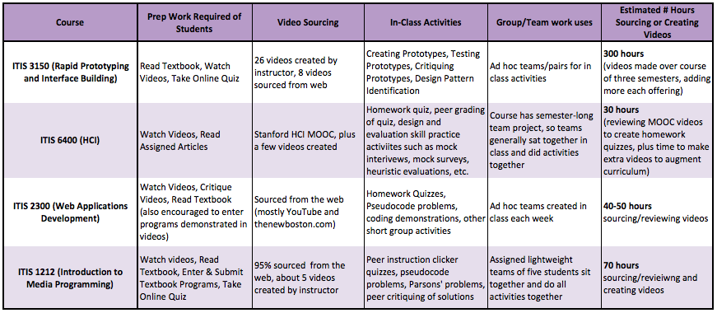
Flipped Courses in SIS
Notes:
In about 30-40% of SIS department courses

Slide 17
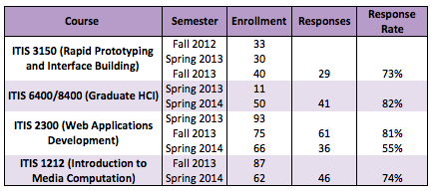
Flipped Classrooms Study
Post-Survey; 7 point Likert scale and 3 Open-Ended items

Slide 18
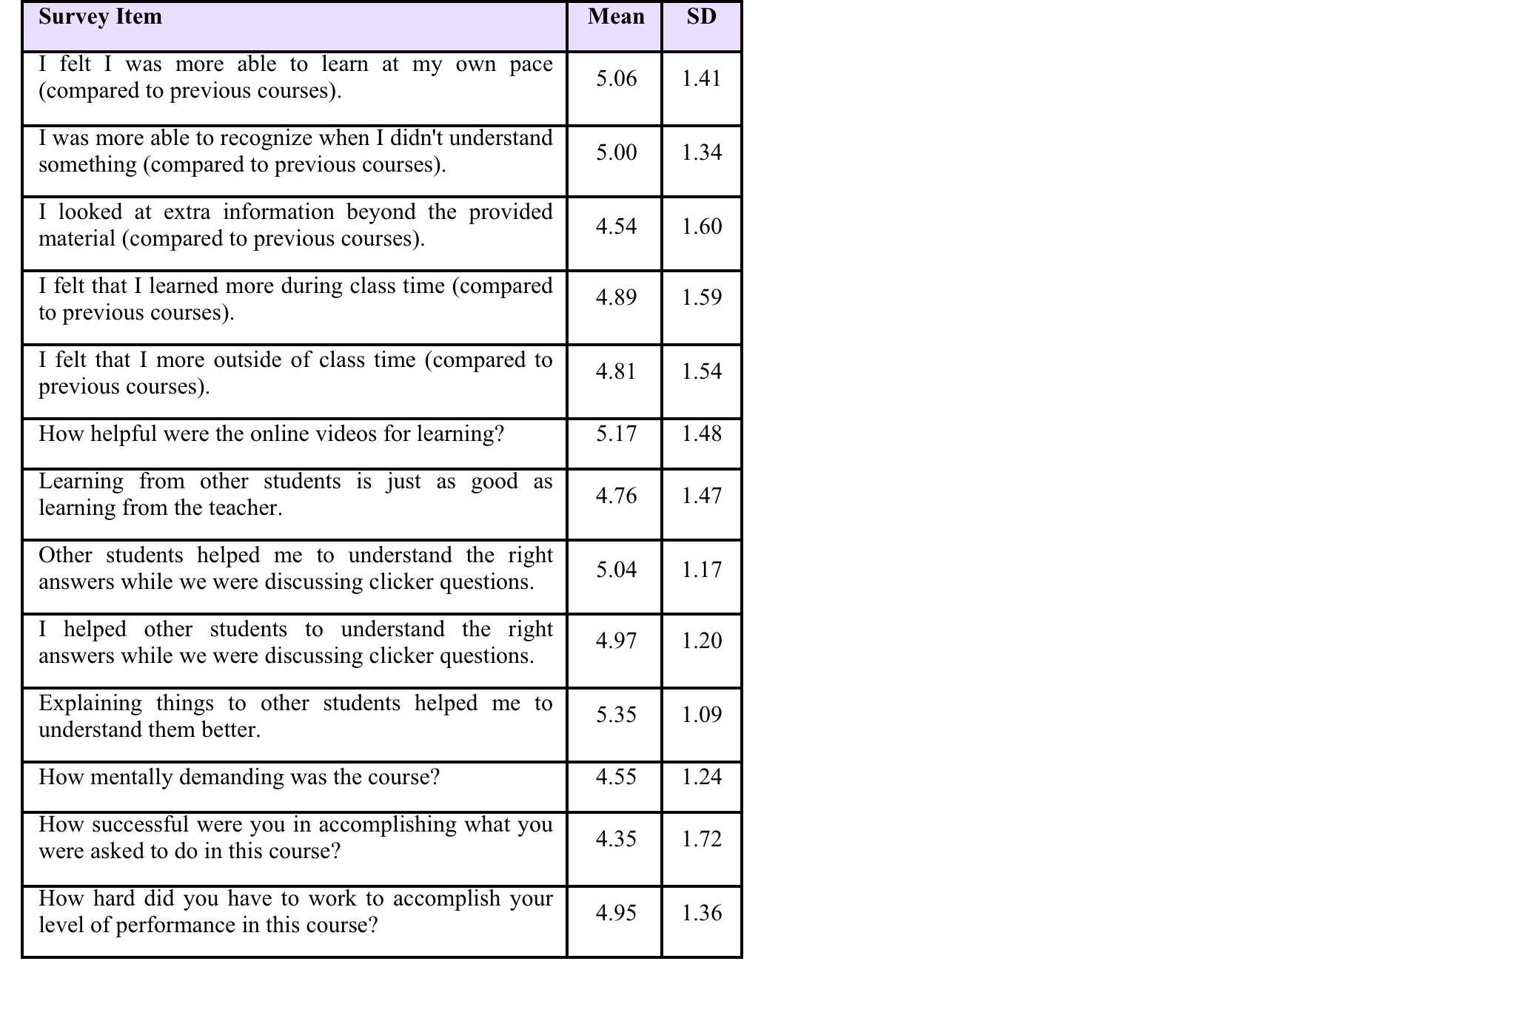
Flipped Classroom Responses
Themes from Open Ended Comments:
Students Liked Interactivity/Hands-on Learning:
“I liked the fact that it was more hands-on than other classes.”
“Being able to work with people is the highlight of this course.”
“I liked how the lab actually helped me learn in the class and all of the videos were helpful.”
A few negative sentiments:
“Time spent outside of the classroom watching videos made me feel like the class was online.”
Notes:
7 point Likert scale, 7 being strongly positive

Slide 19
Lessons Learned and Future Directions
Lessons Learned
Future Directions
Mixed-methods complete the picture
Survey restraint
  Leverage existing resources
  Widespread marketing
Strategic Planning
Unified Degree
Learning Analytics

Slide 20
Appendices

Slide 21
Engagement Survey Constructs and Sample Items
Computing Self-Efficacy
I can complete the programming requirements for a computing/IT major
Help-Seeking/Coping Skills
When I do poorly on an exam, I try to come up with a strategy about what to do
Climate
Degree of interaction with faculty and students
I can relate to the people around me in my classes
Professional Identity
I feel that I "fit" in the field of computing/IT
I know the type of skills I need to be a successful computing/IT student in college and in my future career

Slide 22
Engagement Statistical Analysis
Mann-Whitney Test for Each Semester
  Small sample sizes in post responses, non-parametric approach was used.
Limitation
  Small number of post survey responses
  Self-report, sample bias
  Unknown confounds

Slide 23
2,039
Fall 2014
Notes:
Fall 2008 to fall 2013, 65% increase in enrollment
1924 for fall 2014 + 115 from grad school dual programs (dsba, hcip and hlis- health info)= 2039
The Fall 2014 data are not official census numbers, but is off the chart

Slide 24
Notes:
Between 2008-09 and 2012-13, a 60% increase

